Slide 2

What’s new in F12 for Project Spartan
Andy Sterland
@AndySterland | Andy.Sterland@microsoft.com
Senior Program Manager, Visual Studio, Web Diagnostics
Making Your Web Site Rock with F12
<Insert Session Code Here>

Slide 3

F12

Slide 4
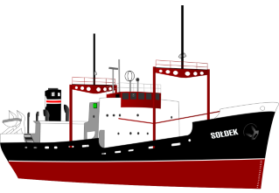
F12 Focus for Win10
Use Project Spartan to finish turning F12 around and get her going in the right direction
Notes:
Public domain image from: https://openclipart.org/detail/2812/soldek

Slide 5
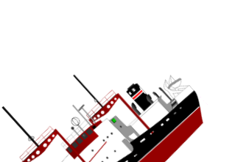


The Road Ahead
Tools for IE11 on Win10+ are frozen
Full steam ahead for Project Spartan
Notes:
Public domain images from:
https://openclipart.org/detail/2812/soldek

Slide 6


Browser Tools – A lot in common
DOM Inspection
Style Tracing
Computed Properties
Layout View
Color Picker
Debugger
Breakpoints
Watches
Console
Console API
CPU profiling
Style profiling
Network tracing
Heap snapshots
Snapshot diffing
Auto completion
Inspect element
Pretty printing
The 80% Case
So, so many tools in the tool box
*Not to scale or remotely mathematically sound!

Slide 7
Browser Tools – A little unique
Network throttling
Device emulation
Pseudo elements
Edit and continue
Paint correlation
CSS animation
Animation scrubbing
More…
3D view
Web audio editor
Animation
Shader editor
Reflow event logging
Responsive design mode
Lots of extensions
More…
TracePoints
Statement level JS
Just my code
Find references
Set next statement
Track changes
TypeScript colouring
More…

Slide 8

Notes:
Dragon from: https://openclipart.org/detail/1057/ddraig
Public domain

Slide 9
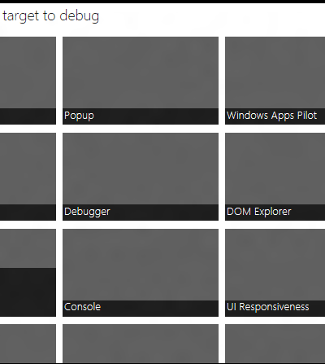
F12 against IE anywhere (locally..)
C:\Windows\System32\F12\F12Chooser.exe

Slide 10
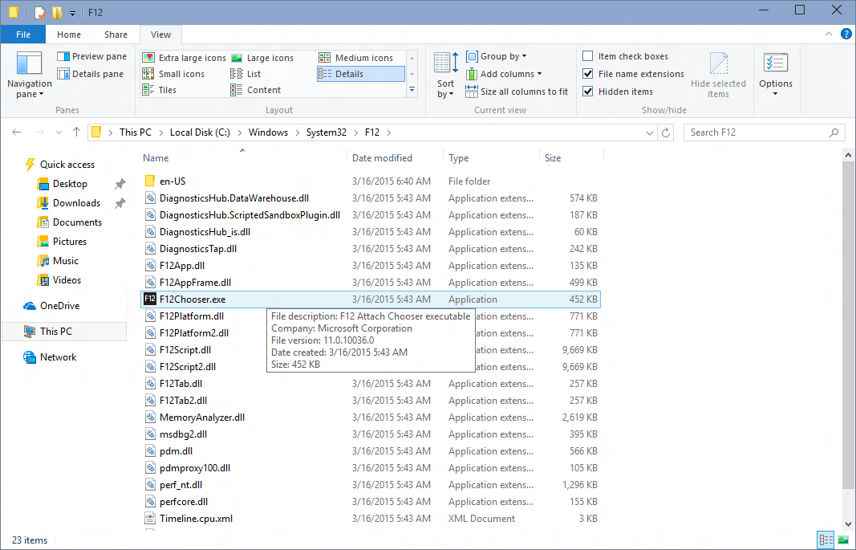
Located at: C:\Windows\System32\F12\F12Chooser.exe

Slide 11
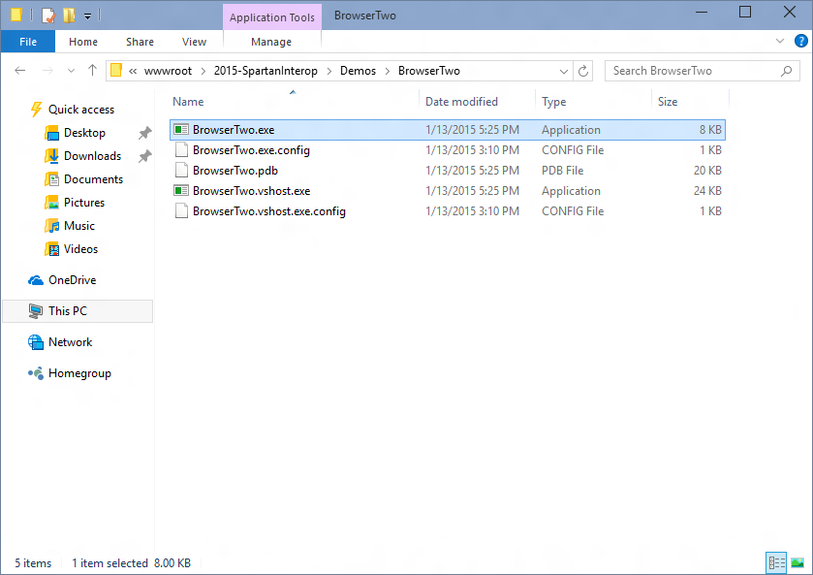
Launch the app you want to debug (winforms, win32, wpf)

Slide 12
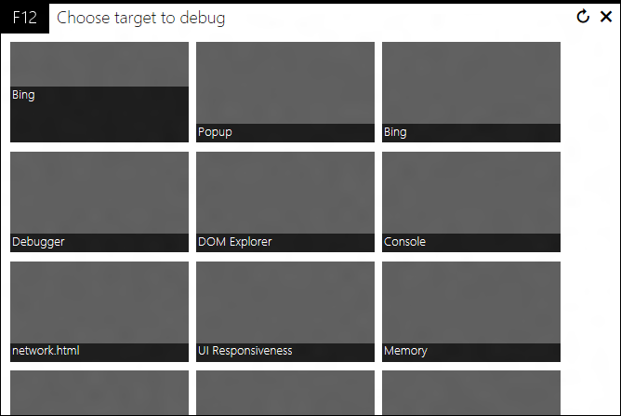
You’ll get something like this with a tile for each app you can debug

Slide 13
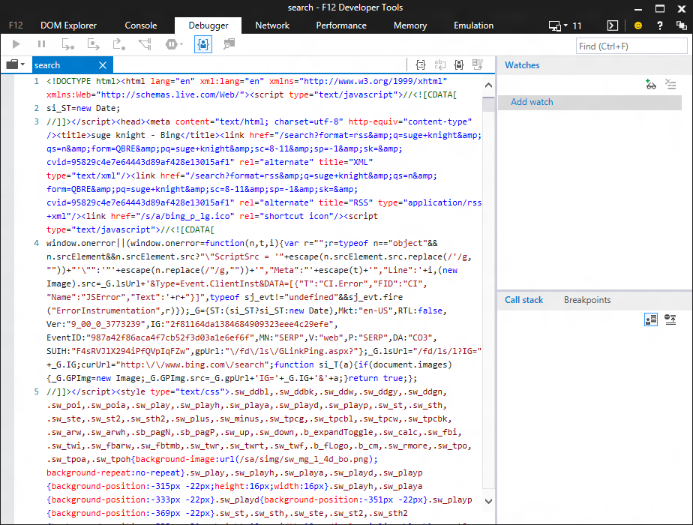
Launches F12 against the app…

Slide 14
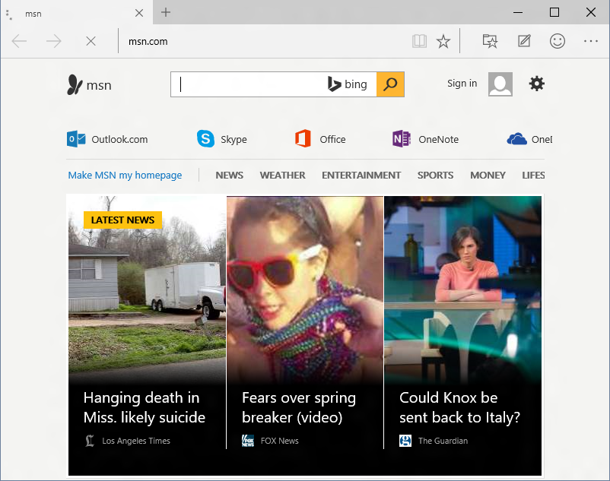
Works for Project Spartan too!
It’s going to be your best bet for the preview flight

Slide 15
F12 Chooser also works against apps that multiple web instances

Slide 16
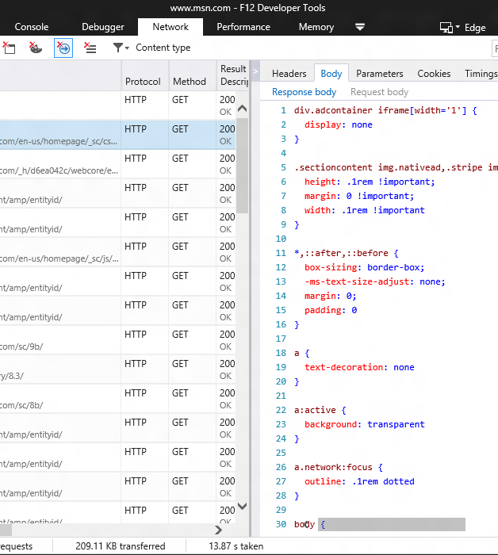
New network tool

Slide 17
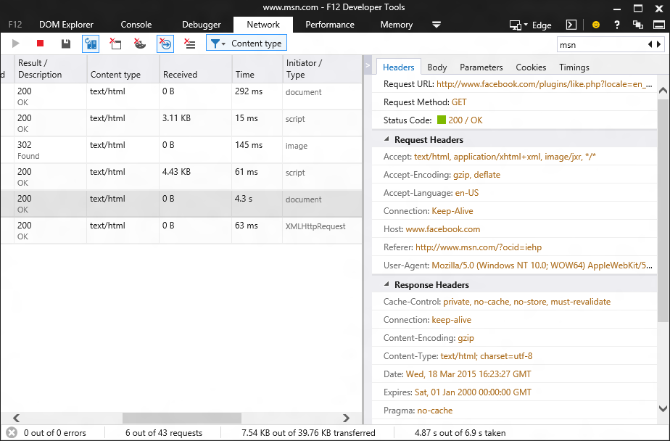
Brand new tool
built in HTML & TypeScript

Slide 18
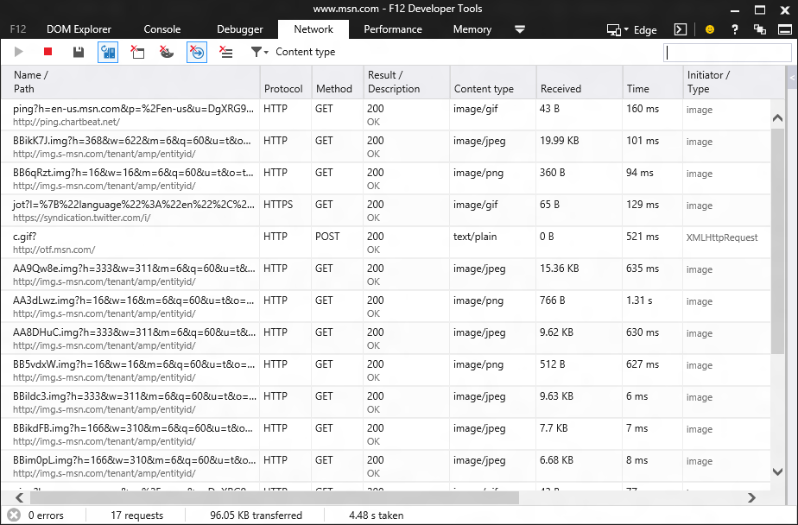
Recording start by default

Slide 19
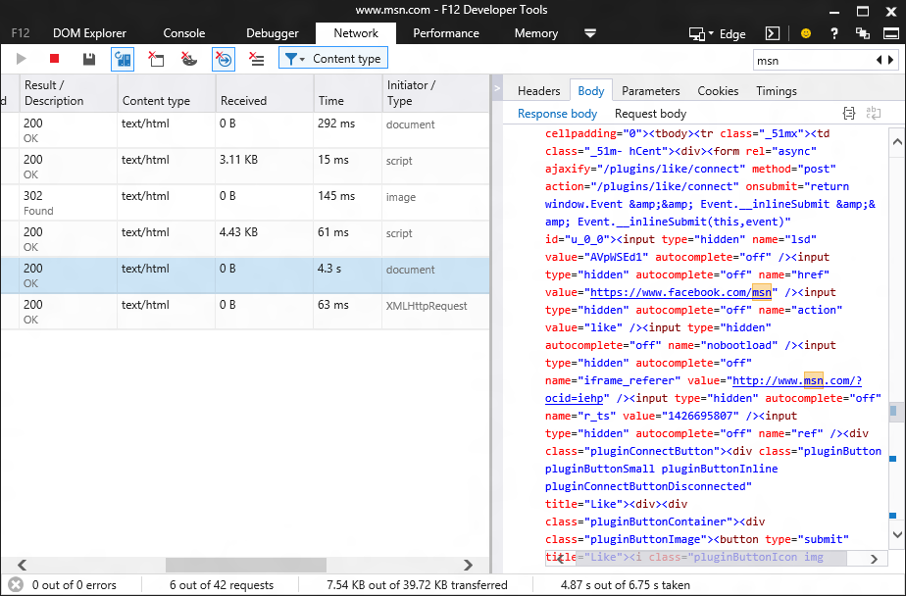
Search all network data

Slide 20
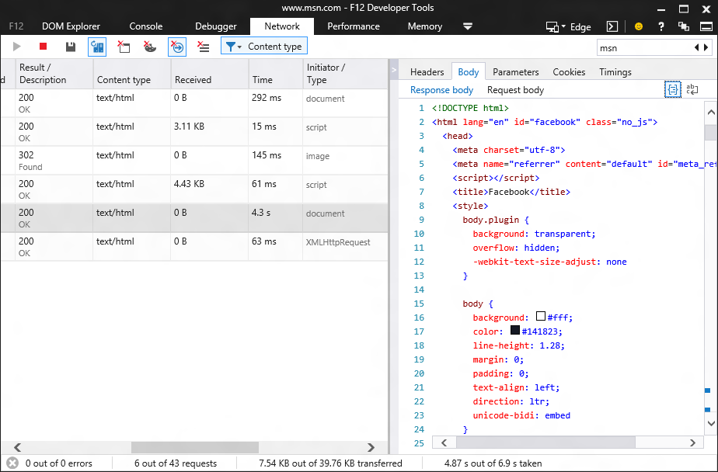
Pretty printing for common file types (including JSON!)

Slide 21
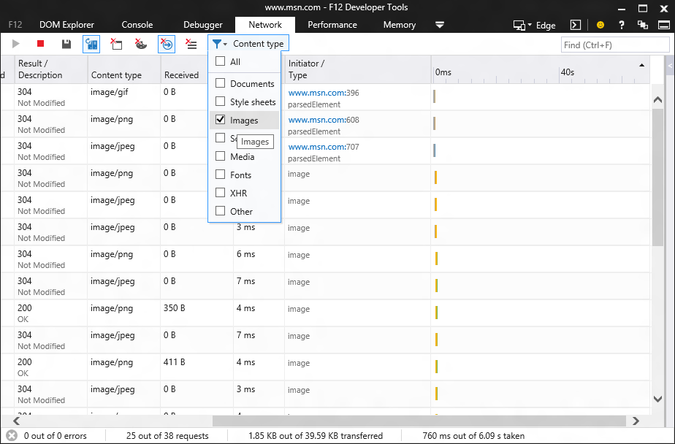
New: Type filtering

Slide 22
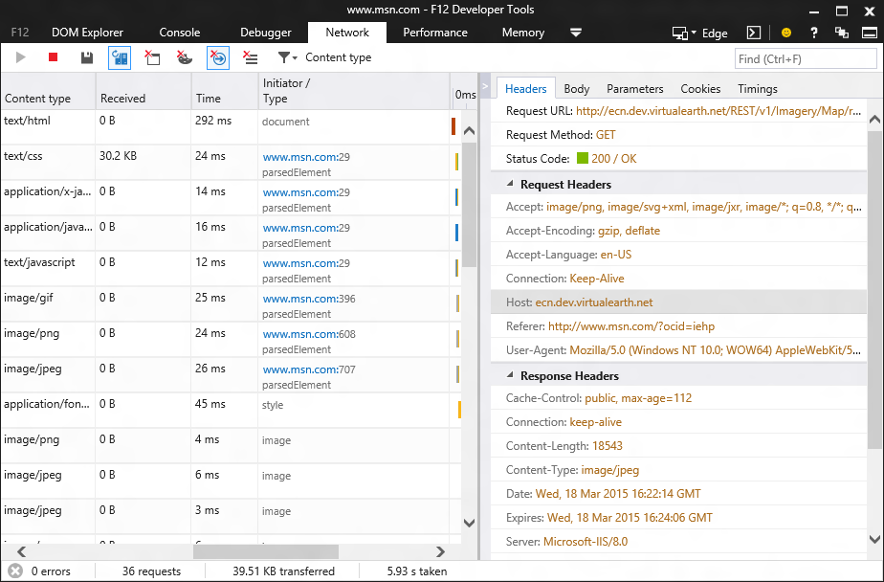
Download initiator

Slide 23
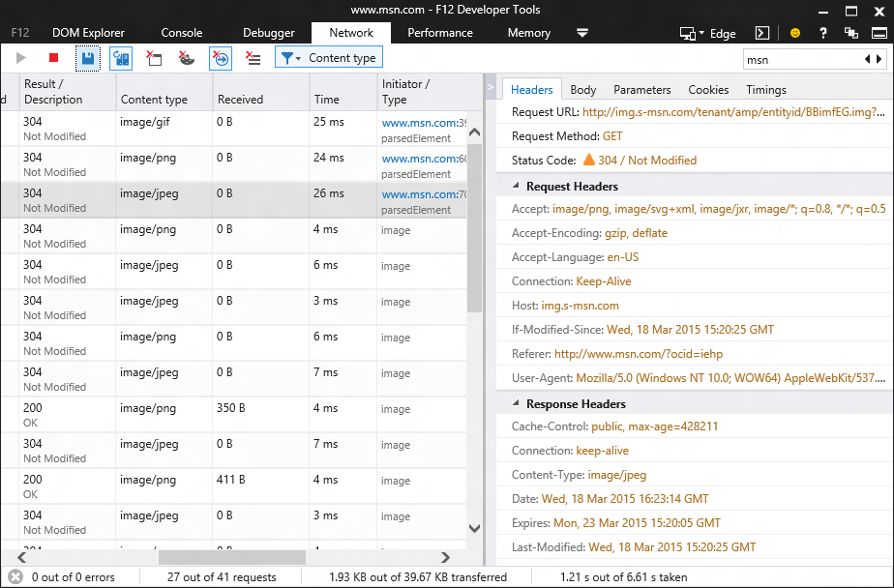
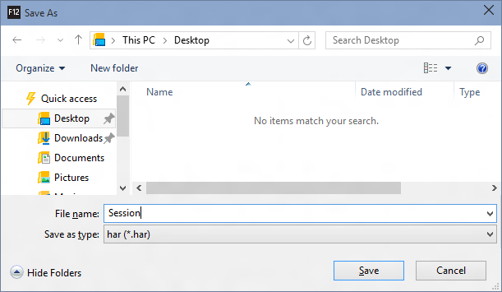
Export to HAR

Slide 24
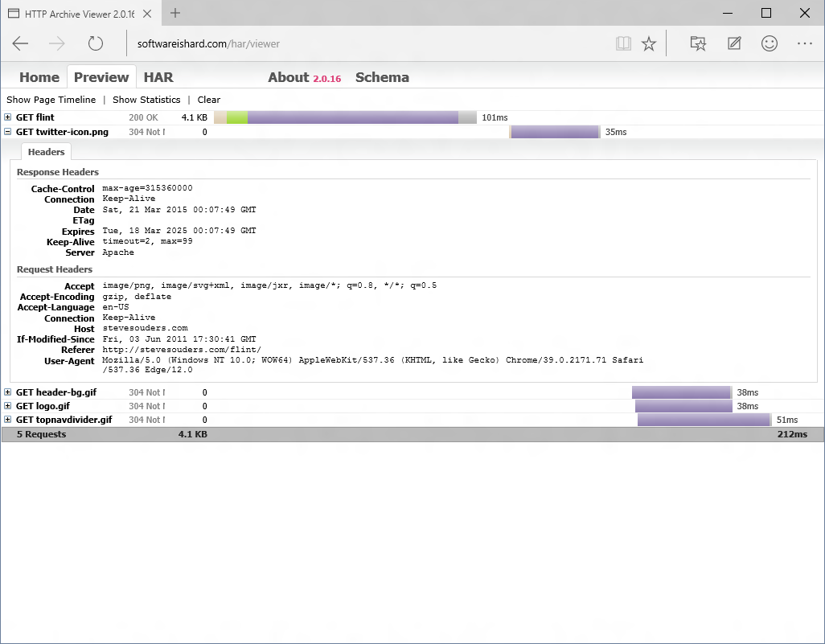

Slide 25
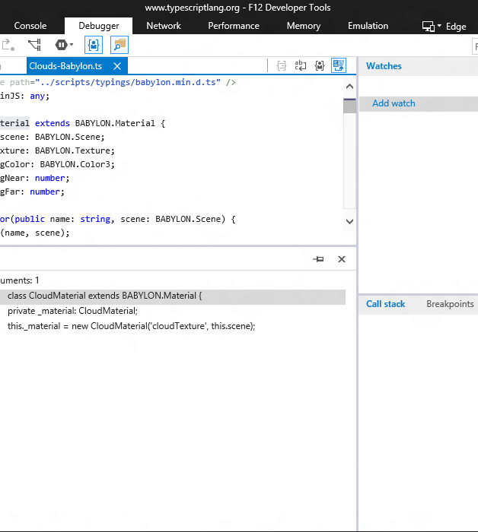
Making hard things easier
better source navigation
find references
go to definition

Slide 26
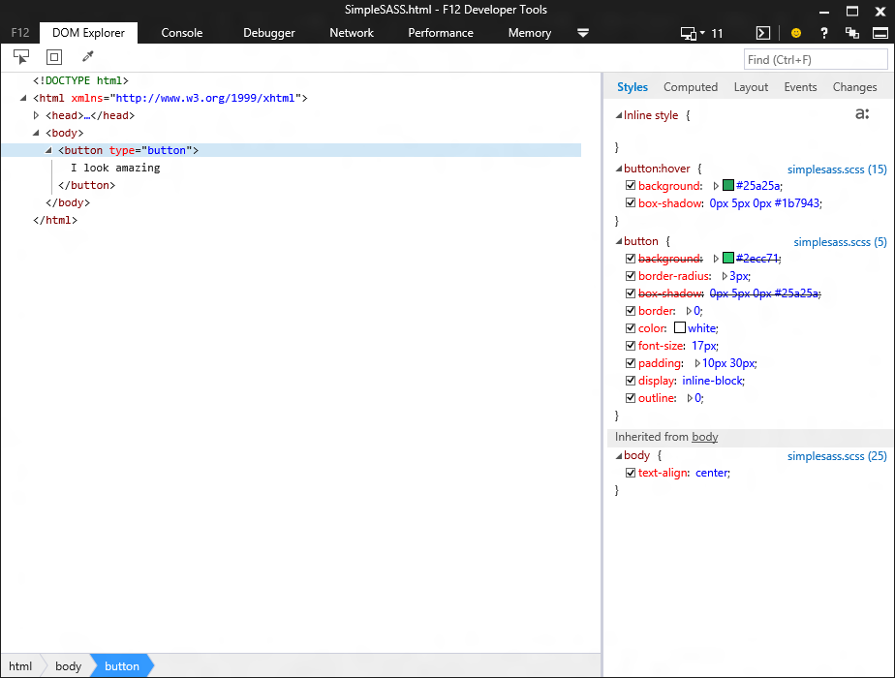
Source mapped style links in the DOM Explorer

Slide 27
Source mapped CSS files in the debugger complete with pretty colors for LESS and SASS

Slide 28
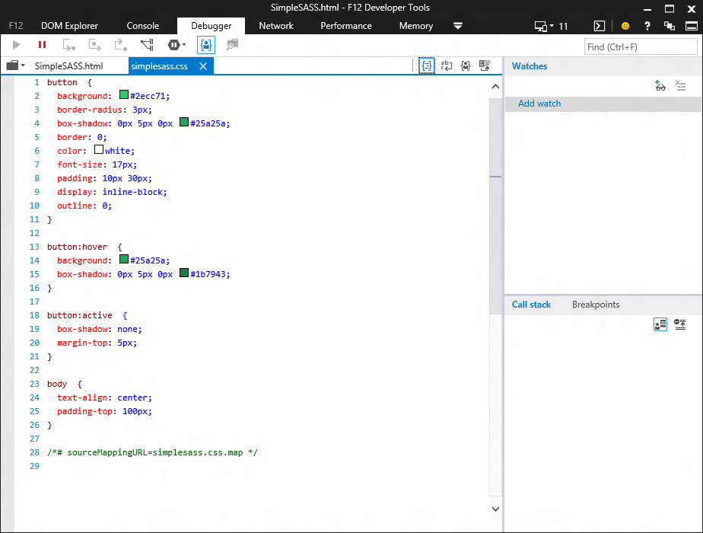
Pretty print CSS

Slide 29
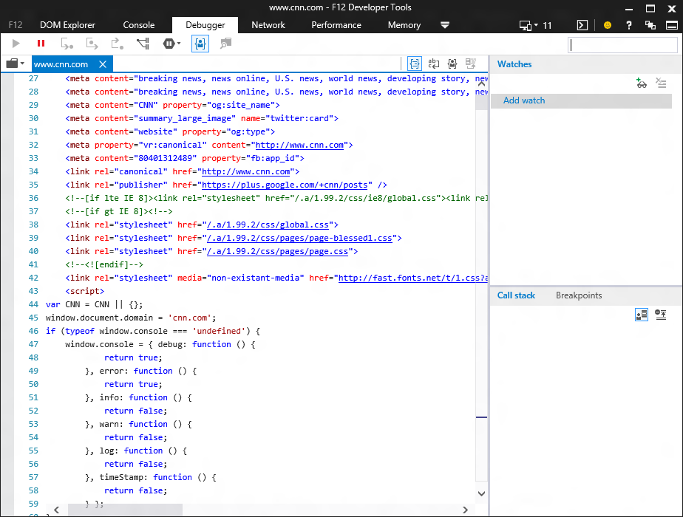
Pretty print HTML (including inline <script> and <style>)

Slide 30
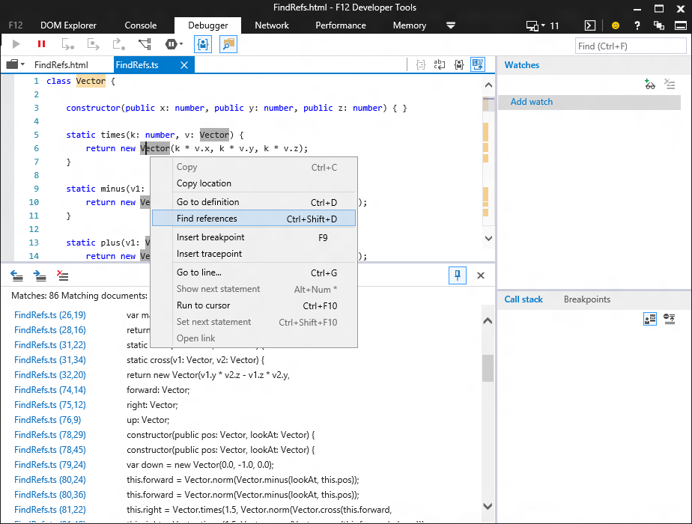
Bringing powerful language features from VS to F12
go to definition and find references works like a charm for TypeScript

Slide 31
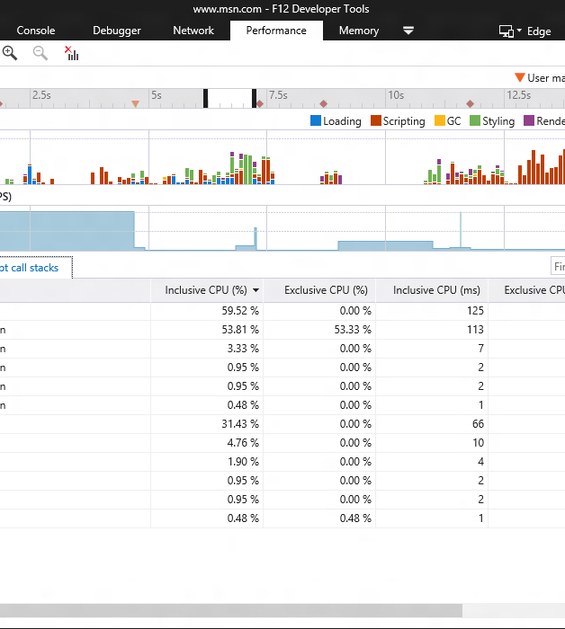
Updated performance tool (nee UI responsiveness tool)
new name
user marks
new cpu profiler

Slide 32
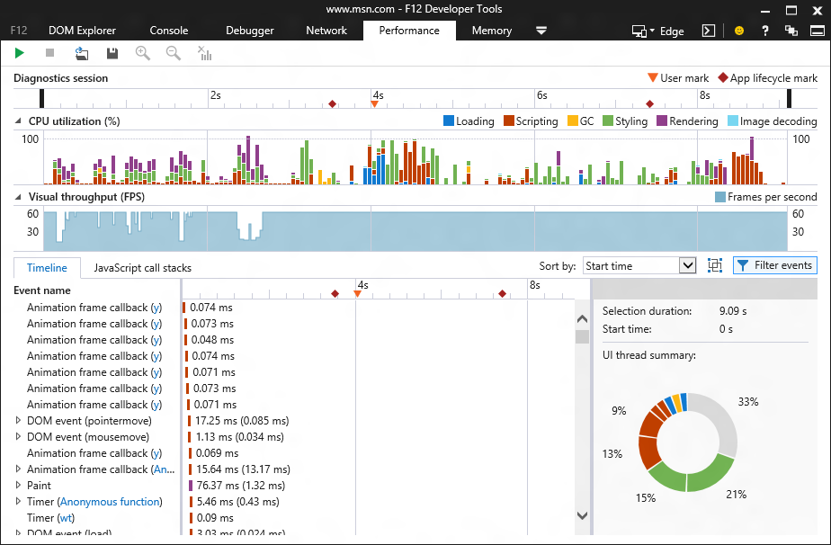
UI responsiveness tool is now named “Performance”

Slide 33
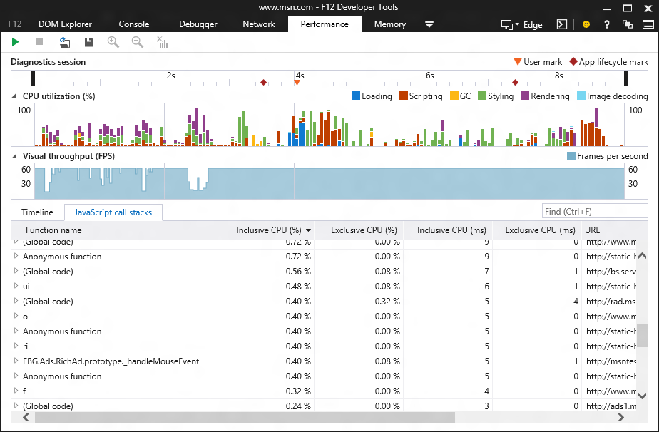
JavaScript profiler now integrated into performance tool sampled so way less overhead than the old profiler

Slide 34
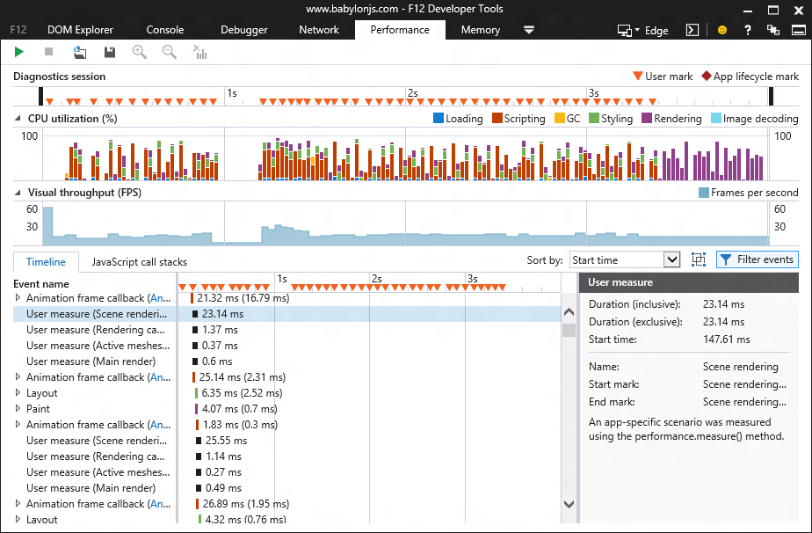
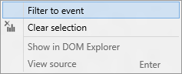
User marks help you tailor the profiler view

Slide 35
Sourcemaps ♥ CSS
better source navigation
sourcemaps for css
pretty print anything

Slide 36
Source mapped style links in the DOM Explorer

Slide 37
Source mapped CSS files in the debugger complete with pretty colors for LESS and SASS

Slide 38
Pretty print CSS

Slide 39
Pretty print HTML (including inline <script> and <style>)

Slide 40
Bringing powerful language features from VS to F12
go to definition and find references works like a charm for TypeScript)

Slide 41

Adding experimental features
javascript editing
css editing
cookie inspection
local and session storage

Slide 42
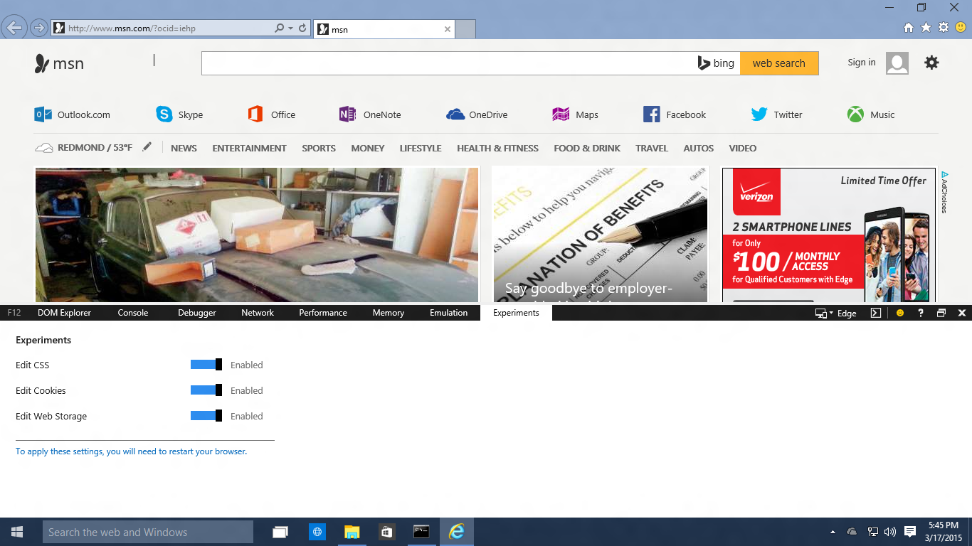
It’ll look something like this…

Slide 43

Join in and help build better tools for you
uservoice.modern.ie
connect.microsoft.com
github.com/microsoft
@IEDevTools

Slide 44
?
QUESTIONS

